Slide 1
RELATIONAL DATABASE MANAGEMENT SYSTEM
Course Code:M23DE0103
School of Computer Science and Applications
I MCA-D
Faculty Name: Prof. Nagaraj C

Slide 2
UNIT 1

Slide 3
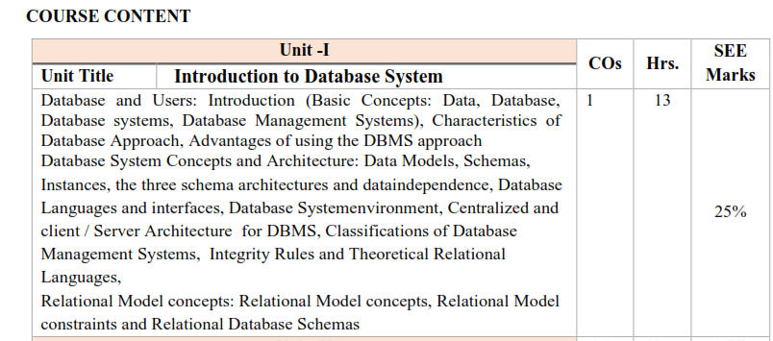

Slide 4
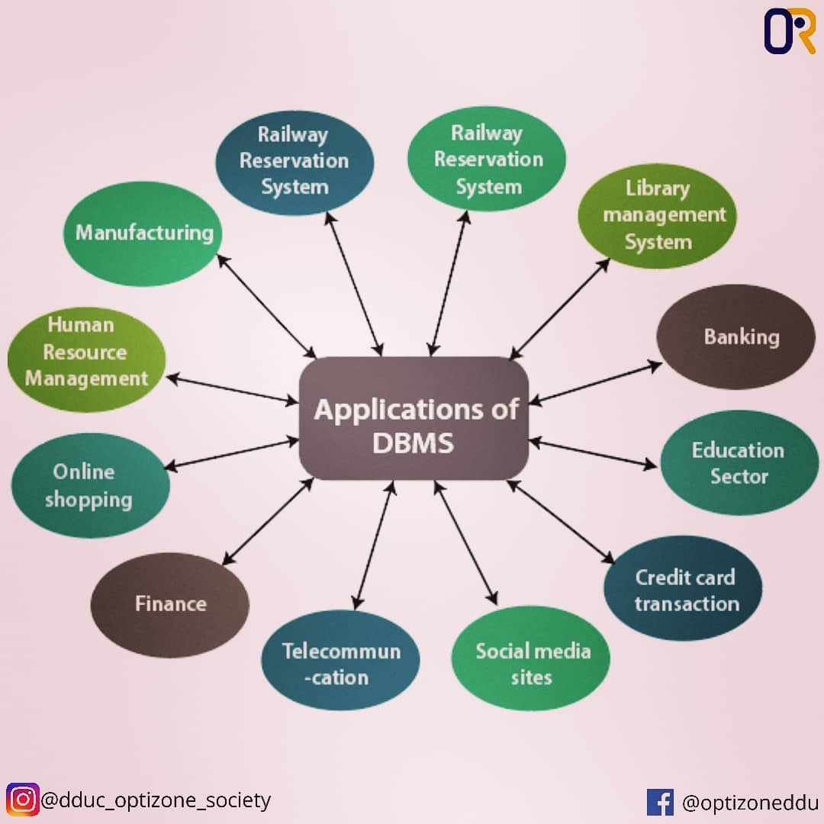
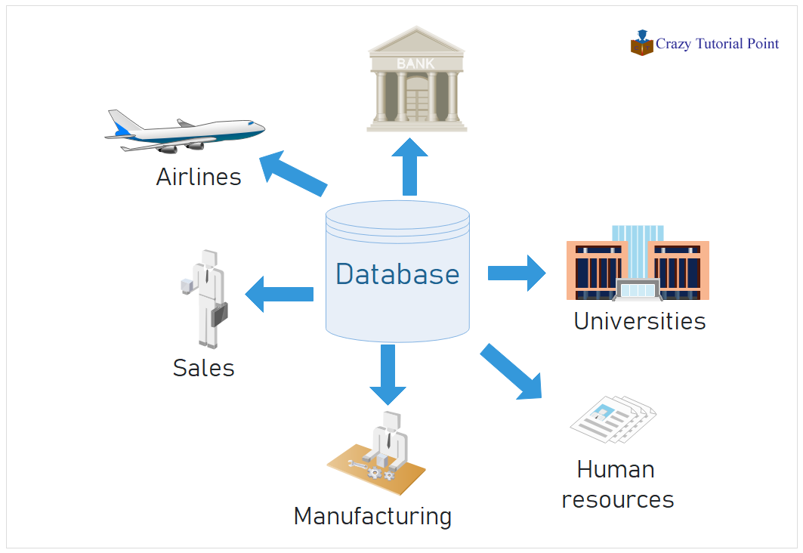
Samples of database- overview
https://www.crazytutorialpoint.com/dbms-tutorial/dbms-application.php
https://www.tutorialandexample.com/applications-of-dbms/

Slide 5
definitions
Data: Raw facts or figures (e.g., numbers, text, or multimedia) that have no inherent meaning until processed or organized.
Database: A structured collection of data that allows for easy access, management, and updating. Example: Student records in a school.
Database Systems: Systems designed to define, store, retrieve, and manage data in databases.
Database Management System (DBMS): Software that allows users and applications to interact with the database efficiently and securely.
Database Catalog: The catalog contains the information such as the structure of each file, the type and storage format of each data item and various constraints on the data.
Metadata: Metadata in DBMS refers to "data about data." It describes the structure, organization, and other properties of the data stored in a database.

Slide 6
Definition
A database-management system (DBMS) is a collection of interrelated data and a set of programs to access those data.
Store and retrieve database information that is both convenient and efficient.
Ensure the safety and restricting unauthorized access.

Slide 7
DBMS - AN INTRODUCTION
Program that helps to store, modify and extract the information from a database.
Computerized Record-Keeping System.
Process of defining, constructing, manipulating the database.
Handles huge amount of data.
Useful for providing a centralized view of data that can be accessed by multiple users from multiple locations.

Slide 8
FUNCTIONS OF DBMS
Defining a database.
Constructing the database
Manipulating the database
Sharing databases among various users
Protecting the database
Maintenance of a database

Slide 9
Features of DBMS
Reduces data redundancy.
Ensures data consistency and integrity.
  Consistency helps ensure that data is accurate, up-to-date (Uniformity of the data across the system)
  Integrity refers specifically to the accuracy, trustworthiness of data and maintain the information’s quality
Supports multiple users with access control.
Provides backup and recovery mechanisms.
Enhances data security.

Slide 10
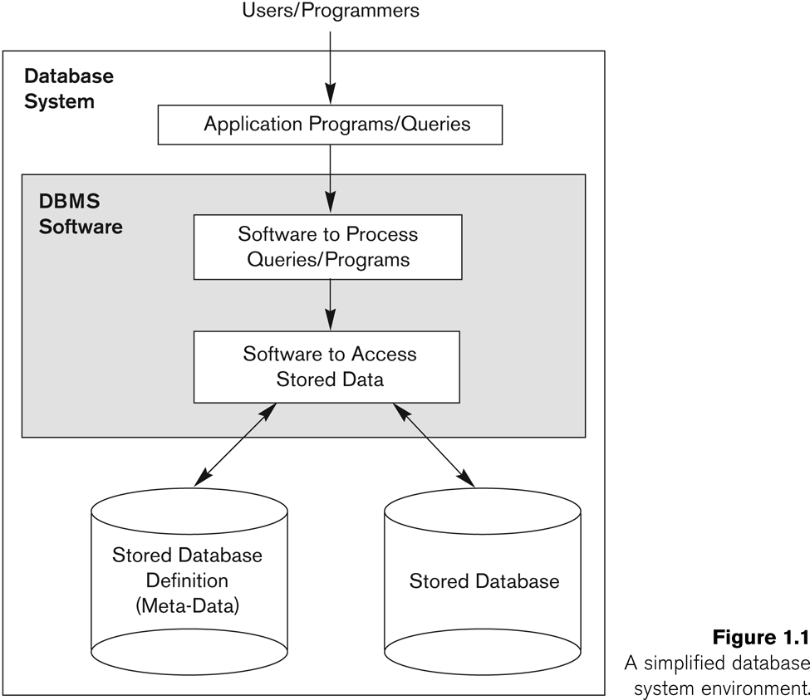
Simplified database system environment

Slide 11
Simplified database system environment
A DBMS (database management system) is a collection of programs that enables users to create and maintain database. The DBMS is a common purpose software system that facilitates the process of constructing, defining, manipulating and sharing databases among various users as well as applications.
Defining a database state the database involves specifying the constraints, data types and structures of the data to be stored in the database.
The descriptive information is as well stored in the database in the form database catalogue or dictionary- it is called meta-data.
Manipulating the data comprises the querying the database to retrieve the specific data.
An application program accesses the database through transferring the quarries or requests for data to DBMS.
The significant function provided by the DBMS includes protecting the database and maintain the database.

Slide 12
Main Characteristics of the Database Approach
Self-Describing Nature of a Database System
A database system contains not only the data but also a description of its structure, known as metadata.
Metadata is stored in the data dictionary, which defines:
  The structure of data (e.g., table names, columns, data types).
  Constraints (e.g., primary key, foreign key).
  Relationships between data elements.
This self-describing nature makes the database system more flexible and reduces dependency on specific programs.

Slide 13
Main Characteristics of the Database Approach
2. Insulation Between Programs and Data (Data Abstraction)
The database approach separates the data from the application programs that use the data.
Changes in the database structure (e.g., adding a new column to a table) do not require changes to application programs.
This characteristic provides data independence:
  Physical Data Independence: Changes to physical storage structures do not affect conceptual schema.
  Logical Data Independence: Changes to the conceptual schema do not affect external schema (user views).

Slide 14
Main Characteristics of the Database Approach
3. Data Abstraction:
  A data model is used to hide storage details and present the users with a conceptual view of the database.
  Programs refer to the data model constructs rather than data storage details
4. Support of multiple views of the data:
  Each user may see a different view of the database, which describes only the data of interest to that user.

Slide 15
Main Characteristics of the Database Approach
5. Sharing of data and multi-user transaction processing:
  A multi-user DBMS, as its name implies, must allow multiple users to access the database at an equivalent time or concurrently.
  Allowing a set of concurrent users to retrieve from and to update the database(many users can access data at the same time)
  Concurrency control within the DBMS guarantees that each transaction is correctly executed or aborted
  Recovery subsystem ensures each completed transaction has its effect permanently recorded in the database
  OLTP (Online Transaction Processing) is a major part of database applications. This allows hundreds of concurrent transactions to execute per second.

Slide 16
Advantages of Using the Database Approach
Controlling redundancy in data storage and in development and maintenance efforts.
  Sharing of data among multiple users.
Restricting unauthorized access to data.
Providing backup and recovery services.
Providing multiple interfaces to different classes of users(DBA,Developer,End Users,Data Analysts)
Representing complex relationships among data.
Enforcing integrity constraints on the database.

Slide 17
Database Users
Users may be divided into
  Those who actually use and control the database content, and those who design, develop and maintain database applications (called “Actors on the Scene”),
Database Administrators (DBAs) are part of the Actors on the Scene because they directly interact with and manage the database content. They are responsible for tasks such as:
Controlling access to the database.
Ensuring data integrity and security.
Managing backups and recovery.
Optimizing database performance.

Slide 18
Database Users
Users may be divided into
  Workers Behind the Scene in a database refer to the technical personnel who design, develop, and maintain the database management system (DBMS) and its supporting infrastructure. These individuals work in the background to ensure the database system operates efficiently, and securely.
1. System Administrators
They manage the hardware and operating systems that host the database.
Responsibilities include installing updates, monitoring server performance, and maintaining system uptime.
2.Computer System Operators:
They manage the day-to-day operations of the systems running the DBMS.

Slide 19
Database Users
Actors on the scene
  Database administrators:
    Responsible for authorizing access to the database, for coordinating and monitoring its use, acquiring software and hardware resources, controlling its use and monitoring efficiency of operations.
  Database Designers:
    Responsible to define the content, the structure, the constraints, and functions or transactions against the database. They must communicate with the end-users and understand their needs.

Slide 20
Database Users
End-users: They use the data for queries, reports and some of them update the database content. End-users can be categorized into:
    Casual: access database occasionally when needed
    Naïve Users
    Sophisticated Users
    Stand-Alone Users

Slide 21
Database Users
Different types of Actors on the Scene who interact with the database in unique ways:
Casual Users:
  These users access the database occasionally and might use query languages (like SQL) to retrieve information.
  They do not interact with the database regularly or in a highly technical way.
  Example: A manager generating a report using predefined queries.

Slide 22
Database Users
2. Naive Users:
These users interact with the database through application interfaces, without understanding the underlying database structure or query languages.
They rely on simple forms or GUIs for tasks like data entry or information retrieval.
Example: A clerk entering customer information into a web-based form.
3.Sophisticated Users:
These are advanced users who write their own queries or scripts to interact with the database.
They have a good understanding of the database's structure and capabilities.
Example: Data analysts or scientists performing complex data queries and analysis.

Slide 23
Database Users
4. Stand-Alone Users:
These are users who create and manage their own databases for personal or small-scale use.
They often use desktop tools or lightweight DBMS solutions.
Example: A researcher using a personal SQLite database for a project.

Slide 24
Difference between File System and DBMS
      The file system is basically a way of arranging the files in a storage medium like a hard disk. The file system organizes the files and helps in the retrieval of files when they are required. File systems consist of different files which are grouped into directories. The directories further contain other folders and files. The file system performs basic operations like management, file naming, giving access rules, etc.
      Database Management System is basically software that manages the collection of related data. It is used for storing data and retrieving the data effectively when it is needed. It also provides proper security measures for protecting the data from unauthorized access. In Database Management System the data can be fetched by SQL queries and relational algebra. It also provides mechanisms for data recovery and data backup

Slide 25
Difference between File System and DBMS
Basics | File System | DBMS
Structure | The file system is a way of arranging the files in a storage medium within a computer. | DBMS is software for managing the database.
Data Redundancy | Redundant data can be present in a file system. | In DBMS there is no redundant data.
Backup-and Recovery | It doesn’t provide Inbuilt mechanism for backup and recovery of data if it is lost. | It provides in house tools for backup and recovery of data even if it is lost.
Query processing | There is no efficient query processing in the file system. | Efficient query processing is there in DBMS.
Consistency | There is less data consistency in the file system. | There is more data consistency because of the process of normalization.
Complexity | It is less complex as compared to DBMS. | It has more complexity in handling as compared to the file system.

Slide 26
Difference between File System and DBMS
Basics | File System | DBMS
Security Constraints | File systems provide less security in comparison to DBMS. | DBMS has more security mechanisms as compared to file systems.
Cost | It is less expensive than DBMS. | It has a comparatively higher cost than a file system.
Data Independence | There is no data independence. | In DBMS data independence exists,
User Access | Only one user can access data at a time. | Multiple users can access data at a time.
Sharing | Data is distributed in many files. So, it is not easy to share data. | Due to centralized nature data sharing is easy
Data Abstraction | It give details of storage and representation of data | It hides the internal details of Database
Attributes | To access data in a file , user requires attributes such as file name, file location. | No such attributes are required.
Security Constraints | File systems provide less security in comparison to DBMS. | DBMS has more security mechanisms as compared to file systems.
Cost | It is less expensive than DBMS. | It has a comparatively higher cost than a file system.

Slide 27
DATABASE APPLICATIONS
Traditional DATABASE APPLICATIONS
Banking
Inventory management system
Airline Reservation system
Library Management System
Hospital Management system
Advanced DATABASE APPLICATIONS
Multimedia Databases
Geographic information system
Data warehouses and OLAP(Online Analytical Processing)
Mobile Databses
Web Databases

Slide 28
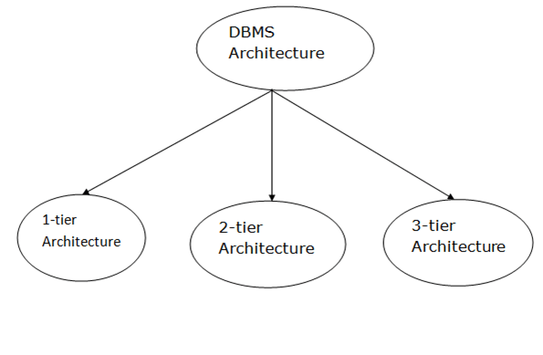
DBMS Architecture
DBMS architecture depends upon how users are connected to the database to get their request done. The client/server architecture consists of many PCs and a workstation which are connected via the network.

Slide 29
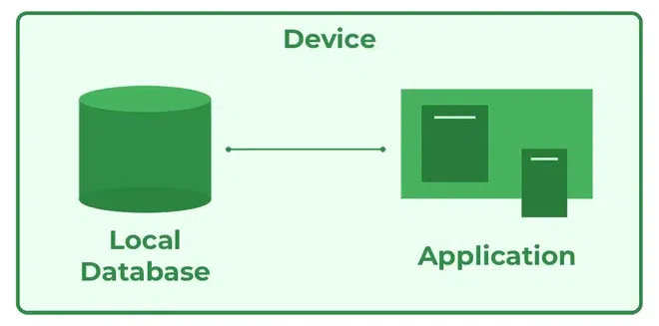
1-Tier Architecture
In this architecture, the database is directly available to the user. It means the user can directly sit on the DBMS and uses it.
Any changes done here will directly be done on the database itself. It doesn't provide a handy tool for end users.
Advantages
    Simple Architecture: 1-Tier Architecture is the most simple architecture to set up, as only a single machine is required to maintain it.
    Cost-Effective: No additional hardware is required for implementing 1-Tier Architecture, which makes it cost-effective.
    Easy to Implement: 1-Tier Architecture can be easily deployed, and hence it is mostly used in small projects.

Slide 30
1-Tier Architecture
Characteristics:
Single-layer setup: User and database reside on the same machine.
Suitable for standalone systems and individual users.
No network is involved.
Low security as the database can be directly accessed by the user.
Real-Time Examples:
Microsoft Access: A simple database where the data and application logic exist on the same computer.
SQLite: Commonly used in mobile or embedded devices where the database and the application run on the same device.
Scenario: You have a grocery list stored in an Excel file.
How it works: You open the file and directly edit or read the data yourself.

Slide 31
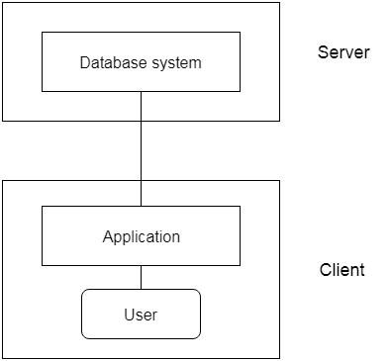
2-Tier Architecture
The 2-Tier architecture is same as basic client-server. In the two-tier architecture, applications on the client end can directly communicate with the database at the server side. For this interaction, API's like: ODBC, JDBC are used.
The user interfaces and application programs are run on the client-side.
The server side is responsible to provide the functionalities like: query processing and transaction management.
To communicate with the DBMS, client-side application establishes a connection with the server side.

Slide 32
2-Tier Architecture
Characteristics:
Client-Server model: The client handles the user interface and application logic, while the server manages the database.
Network is required for communication between client and server.
Communication Process:
The client sends a request (SQL query) to the server.
The server processes the query and sends the results back.
Real-Time Examples:
Online Banking Systems:
  The client (user's browser or app) interacts with the server to fetch account details or perform transactions.

Slide 33
2-Tier Architecture
Real-Time Examples:
2.Example: ATM Machine
Scenario: You go to an ATM to withdraw money.
How it works:
  The ATM machine (Client) is the interface where you input your request (e.g., withdrawing $100).
  The ATM communicates directly with the bank's database (Server) to check your account balance and approve/deny the transaction.

Slide 34
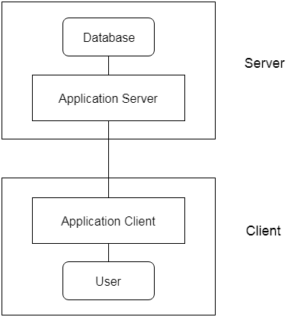
3-Tier Architecture
The 3-Tier architecture contains another layer between the client and server. In this architecture, client can't directly communicate with the server.
The application on the client-end interacts with an application server which further communicates with the database system.
The 3-Tier architecture is used in case of large web application.
Data Integrity: 3-Tier Architecture maintains Data Integrity. Since there is a middle layer between the client and the server, data corruption can be avoided/removed.
Security: 3-Tier Architecture Improves Security. This type of model prevents direct interaction of the client with the server thereby reducing access to unauthorized data.

Slide 35
3-Tier Architecture
In 3-Tier architecture, the system is divided into three layers:
Presentation Layer (User Interface),
Application Layer (Business Logic),
Database Layer (Data Storage).
Characteristics:
The client interacts with the application server, which in turn communicates with the database.
Layers are independent, making the system modular and scalable.
Best suited for enterprise-level applications.

Slide 36
3-Tier Architecture
Real-Time Examples:
E-Commerce Platforms:
  Amazon or Flipkart where:
    The Presentation Layer is the user interface (website/app).
    The Application Layer processes business logic (e.g., calculating discounts, managing orders).
    The Database Layer stores user information, product data, and transaction records.
Online Food Delivery:
  Apps like Swiggy:
    Presentation Layer: User selects food items and places an order.
    Application Layer: Matches restaurants, calculates delivery times, etc.
    Database Layer: Stores menu items, user addresses, order history.

Slide 37
Key Differences Between Architectures:
Feature | 1-Tier | 2-Tier | 3-Tier
Layers | Single layer | Client and Server | Presentation, Application, Database
Communication | Direct | Client communicates with DB | Client → App Server → DB Server
Examples | SQLite, MS Access | Online Banking, Tally ERP | Amazon, Swiggy, Salesforce
Security | Low | Moderate | High

Slide 38
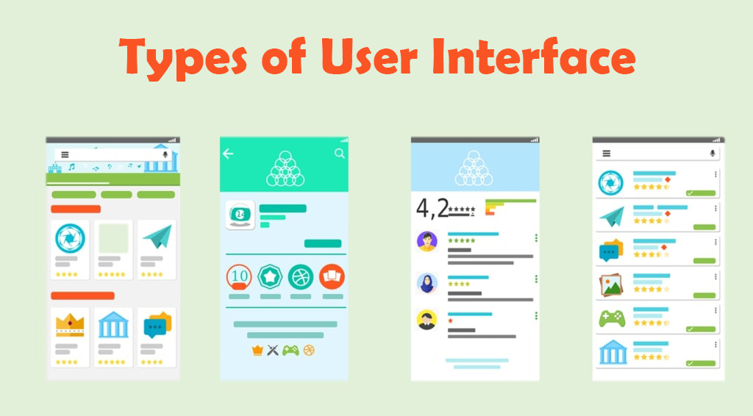
Interfaces in DBMS
An interface is a program that allows users to input queries into a database without writing the code in the query language. An interface can be used to manipulate the database for adding, deleting, updating, or viewing the data.
A user interface or UI is a process of interaction of the user with the computer, website, app or any other screen.

Slide 39

Interfaces in DBMS-Types
Menu-Based Interfaces
  These interfaces present the user with lists of options (called menus) that lead the user through the formation of a request. The basic advantage of using menus is that they remove the tension of remembering specific commands and syntax of any query language. The query is basically composed step by step by collecting or picking options from a menu that is shown by the system. Pull-down menus are a very popular technique in Web-based interfaces. They are also often used in browsing interfaces which allow a user to look through the contents of a database in an exploratory and unstructured manner.

Slide 40
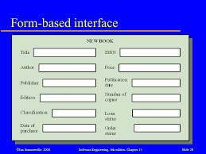
Interfaces in DBMS-Types
2. Forms-Based Interfaces
A forms-based interface displays a form to each user. Users can fill out all of the form entries to insert new data, or they can fill out only certain entries, in which case the DBMS will redeem the same type of data for other remaining entries. These types of forms are usually designed or created and programmed for users that have no expertise in operating systems. Many DBMS’s have form specification languages which are special languages that help specify such forms.

Slide 41

Interfaces in DBMS-Types
3. Natural Language Interface
A natural language interface contains its unique schema more like the high−level conceptual schema. It also has a directory of important words. It generates a query based on the interpretation of important words in the input by the user and if the interpretation is successful, then it displays the result to the user.
Example: A user googled the fastest car in India, and now the natural language interface will look for the important words i. e. fastest, car, India, and show the result accordingly.

Slide 42
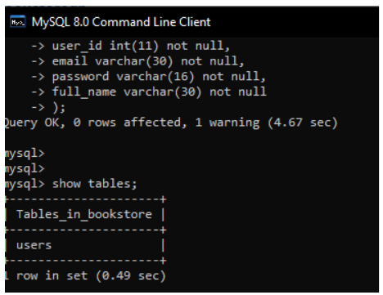
Interfaces in DBMS-Types
4. Command-line interface (CLI)
Almost every database vendor has its own Command-Line Interface (CLI) tool. The following list shows you a couple of examples.
Oracle: sqlplus (SQL Command Line for SQL*Plus)
MySQL: mysql
Microsoft SQL Server: sqlcmd

Slide 43
database languages
Data Definition Language (DDL).
Data Manipulation Language. (DML).
Data Control Language. (DCL).
DQL – Data Query Language
Transaction Control Language (TCL).

Slide 44
1. Data-Definition Language (DDL):
database languages
To specify a database schema by a set of definitions.
Data Definition Language actually consists of the SQL commands that can be used to define the database schema. It simply deals with descriptions of the database schema and is used to create and modify the structure of database objects in the database.

Slide 45
Data-Definition Language (DDL):
database languages
List of DDL commands:
CREATE: This command is used to create the database or its objects (like table, index, function, views).
DROP: This command is used to delete/drop objects from the database.
ALTER: This is used to alter the structure of the database.
TRUNCATE: This is used to remove all records from a table, including all spaces allocated for the records are removed.
COMMENT: This is used to add comments to the data dictionary.
RENAME: This is used to rename an object existing in the database.

Slide 46
Data-Definition Language (DDL):
database languages
List of DDL commands:
CREATE TABLE table_name (
column1 datatype [constraint],
column2 datatype [constraint],
...
columnN datatype [constraint]
);

Slide 47
Data-Definition Language (DDL):
database languages
List of DDL commands:
CREATE TABLE EMPLOYEES (
EMP_ID NUMBER(5) PRIMARY KEY,
FIRST_NAME VARCHAR2(50) NOT NULL,
LAST_NAME VARCHAR2(50) NOT NULL,
EMAIL VARCHAR2(100) UNIQUE,
HIRE_DATE DATE NOT NULL,
SALARY NUMBER(10, 2)
);

Slide 48
Data-Definition Language (DDL):
database languages
Examples of DDL commands:
ALTER TABLE EMPLOYEES ADD DEPARTMENT_ID NUMBER(5);
ALTER TABLE employees DROP COLUMN email;
ALTER TABLE employees MODIFY (salary NUMBER(12,2));
ALTER TABLE employees MODIFY (phone_number VARCHAR2(20));
ALTER TABLE table_name RENAME COLUMN old_column_name TO new_column_name;
TRUNCATE TABLE employees;

Slide 49
Data-Definition Language (DDL):
database languages
List of DDL commands:
In Oracle, you can add comments to a database table or its columns using the COMMENT ON statement. These comments are useful for documentation purposes and can help describe the purpose or meaning of tables and columns.
Syntax:
To comment on a table:
COMMENT ON TABLE table_name IS 'Your comment here';
To comment on a column:
COMMENT ON COLUMN table_name.column_name IS 'Your comment here';

Slide 50
Data-Definition Language (DDL):
database languages
Examples:
Add a comment to a table:
COMMENT ON TABLE EMPLOYEES IS 'This table stores employee details.';
Add a comment to a column:
COMMENT ON COLUMN EMPLOYEES.EMP_ID IS 'Primary key representing the employee ID.';
Remove a comment:
COMMENT ON COLUMN EMPLOYEES.EMP_ID IS NULL;

Slide 51
Data-Definition Language (DDL):
database languages
Examples:
Viewing Comments:
You can retrieve table and column comments using the following system views:
For table comments:
SELECT * FROM USER_TAB_COMMENTS WHERE TABLE_NAME = 'EMPLOYEES';
For column comments:
SELECT * FROM USER_COL_COMMENTS WHERE TABLE_NAME = 'EMPLOYEES';

Slide 52
2. DML (Data Manipulation Language)
database languages
The SQL commands that deals with the manipulation of data present in the database belong to DML or Data Manipulation Language and this includes most of the SQL statements. It is the component of the SQL statement that controls access to data and to the database.
Retrieval of information stored in the database.
Insertion of new information into the database.
Deletion of information from the database.
Modification of information stored in the database.

Slide 53
2. DML (Data Manipulation Language)
database languages
Command | Description | Syntax
INSERT | Insert data into a table | INSERT INTO table_name (column1, column2, ...) VALUES (value1, value2, ...);
UPDATE | Update existing data within a table | UPDATE table_name SET column1 = value1, column2 = value2 WHERE condition;
DELETE | Delete records from a database table | DELETE FROM table_name WHERE condition;

Slide 54
Data manipulation language
database languages
List of DML commands:
Select: It is used to retrieve data from a database.
INSERT : It is used to insert data into a table.
UPDATE: It is used to update existing data within a table.
DELETE : It is used to delete records from a database table.

Slide 55
database languages
Data control language
To control the objects.
To grant and revoking privileges on objects.
List of DCL commands:
GRANT: This command gives users access privileges to the database.
REVOKE: This command withdraws the user’s access privileges given by using the GRANT command.

Slide 56
database languages
4. TCL (Transaction Control Language)
TCL is used to run the changes made by the DML statement.
Here are some tasks that come under TCL:
  Commit: It is used to save the transaction on the database.
  Example: commit;
  Set autocommit on;--This can be used to perform commit operation automatically
  Set autocommit off;--This can be used to put off the autocommit feature.
  Rollback: It is used to restore the database to original since the last Commit.
    Example: rollback;

Slide 57
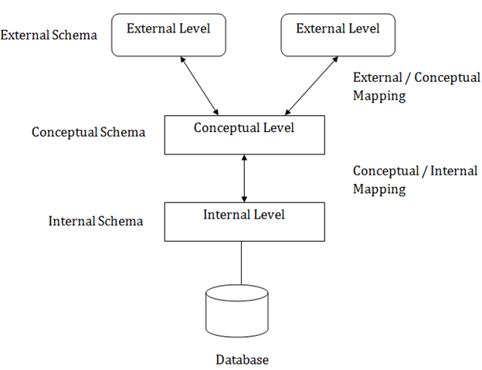
Three schema Architecture
This framework is used to describe the structure of a specific database system.
The three schema architecture is also used to separate the user applications and physical database.
The three schema architecture contains three-levels. It breaks the database down into three different categories.

Slide 58
Three schema Architecture
1. External Level (View Level)
This is how users see the data. Each user or group of users gets a specific view of the database.
Purpose: Provides security by hiding irrelevant data and simplifies the database for user-specific tasks.
Real-Time Example:
A Bank’s Customer Portal shows:
  Customers see their account balance, transaction history, etc.
  Bank managers see customers' loan details and credit scores.

Slide 59
Three schema Architecture
2. Conceptual Level (Logical Level)
Represents the entire structure of the database logically, independent of how it's stored.
Purpose: Focuses on what data is stored and relationships between them (entities, attributes, constraints).
Real-Time Example:
The bank’s conceptual schema includes:
  Tables like Accounts, Customers, and Loans.
  Relationships: One customer can have multiple accounts.

Slide 60
Three schema Architecture
3. Internal Level (Physical Level)
Describes how the data is physically stored in the database (files, indexes, storage format).
It is the lowest level of abstraction.It does not hide the storage details.
Purpose: Optimizes performance, handles storage details, and ensures efficient data access.
Real-Time Example:
  Data for Accounts is stored in rows and columns in data files on disk.
  Indexes are used for fast lookup of account numbers.

Slide 61
Three schema Architecture
Mapping is used to transform the request and response between various database levels of architecture.
Mapping is not good for small DBMS because it takes more time.
In External / Conceptual mapping, it is necessary to transform the request from external level to conceptual schema.
In Conceptual / Internal mapping, DBMS transform the request from the conceptual to internal level.

Slide 62
Objectives of Three schema Architecture
The main objective of three level architecture is to enable multiple users to access the same data with a personalized view while storing the underlying data only once. Thus it separates the user's view from the physical structure of the database. This separation is desirable for the following reasons:
  Different users need different views of the same data.
  The approach in which a particular user needs to see the data may change over time.
  The users of the database should not worry about the physical implementation and internal workings of the database such as data compression and encryption techniques, hashing, optimization of the internal structures etc.
  All users should be able to access the same data according to their requirements.
  DBA should be able to change the conceptual structure of the database without affecting the user's
  Internal structure of the database should be unaffected by changes to physical aspects of the storage.

Slide 63
Mapping between Views
The three levels of DBMS architecture don't exist independently of each other. There must be correspondence between the three levels i.e. how they actually correspond with each other. DBMS is responsible for correspondence between the three types of schema. This correspondence is called Mapping.
There are basically two types of mapping in the database architecture:
  Conceptual/ Internal Mapping
  External / Conceptual Mapping

Slide 64
Mapping between Views
External/ Conceptual Mapping
The external/Conceptual Mapping lies between the external level and the Conceptual level. Its role is to define the correspondence between a particular external and the conceptual view.
Conceptual/ Internal Mapping
The Conceptual/ Internal Mapping lies between the conceptual level and the internal level. Its role is to define the correspondence between the records and fields of the conceptual level and files and data structures of the internal level.

Slide 65
Data Models
In RDBMS, data models define how data is logically structured, stored, and manipulated. They ensure the organization of data in a structured manner so that it can be retrieved, updated, and managed efficiently.
Abstract model describes how the data are represented and used.
Consists of set of data structures, conceptual tools to describe the structure of a database.
Entities: Objects or things we want to store data about (e.g., Students, Courses).
Attributes: Properties of an entity (e.g., Name, Age, Grade for a Student).
Relationships: How entities are connected (e.g., Students enroll in Courses).

Slide 66
1.Conceptual Data Model
A Conceptual Data Model is a high-level, abstract representation of the system's data. It focuses on what data is needed and how it is related, rather than how it is stored or implemented.
Audience: Business stakeholders, analysts, and designers.
Purpose: To understand the system’s requirements and data at a high level.
Features
Focuses on entities (objects or things) and relationships (connections between entities).
No technical or storage details (e.g., no data types or tables).
Represents the business perspective of data.
Example: School Management System
Entities: Student, Teacher, Course, Classroom.

Slide 67
2. Logical Data Model
A Logical Data Model builds on the conceptual model by adding more detail. It describes the structure of data, including attributes and relationships, but still avoids implementation-specific details.
Audience: Database designers and architects.
Purpose: To refine the data design for a database system.
Features
Includes entities, attributes, and keys (e.g., primary and foreign keys).
Represents normalization (reduces redundancy).
Independent of any specific database or technology.

Slide 68
2. Logical Data Model
Example: Student Management System (Logical Model)
Entities and Attributes:
  Student: StudentID (Primary Key), Name, Age, Grade.
  Course: CourseID (Primary Key), CourseName, Credits.
  Enrollment: StudentID (Foreign Key), CourseID (Foreign Key), EnrollmentDate.

Slide 69
3. Physical Data Model
The Physical Data Model translates the logical model into a design that can be implemented in a specific database system. It includes technical details like table structures, data types, indexes, and constraints.
Audience: Database administrators (DBAs) and developers.
Purpose: To implement the database system with optimized performance.
Features
Defines tables, columns, and data types (e.g., VARCHAR, INT).
.

Slide 70
3. Physical Data Model
Example:
CREATE TABLE Student (StudentID INT PRIMARY KEY,Name VARCHAR(100),Age INT,Grade VARCHAR(10));
CREATE TABLE Course (CourseID INT PRIMARY KEY,CourseName VARCHAR(100),Credits INT);
CREATE TABLE Enrollment (StudentID INT,CourseID INT, EnrollmentDate DATE,
FOREIGN KEY (StudentID) REFERENCES Student(StudentID),
FOREIGN KEY (CourseID) REFERENCES Course(CourseID));

Slide 71
4. Hierarchical Data Model
The Hierarchical Data Model organizes data in a tree-like structure, where data is stored as parent-child relationships. Each parent can have multiple children, but each child has only one parent.
Audience: Used in early database systems or systems with hierarchical data.
Purpose: To represent data with a strict hierarchy.
Features
Data is stored in a tree structure with nodes.
Relationships are 1-to-many (one parent, many children).
Fast traversal for hierarchical data but lacks flexibility for complex relationships.

Slide 72
4. Hierarchical Data Model
Example: Organization Hierarchy
  Parent: CEO.
  Children: Managers.
  Sub-children: Employees.
Representation:
CEO
├── Manager 1
│ ├── Employee A
│ ├── Employee B

Slide 73
5. Entity-Relationship (ER) Model
An ER Model visually represents the structure of data using entities, attributes, and relationships. It is typically used during the design phase of a database to understand the data requirements.
Audience: Database designers and architects.
Purpose: To document and analyze data requirements before implementation.
Features
Entities: Represent objects (e.g., Student, Course).
Attributes: Properties of entities (e.g., Name, Age).
Relationships: Links between entities (e.g., "Student enrolls in Course").
Often represented using ER diagrams.

Slide 74
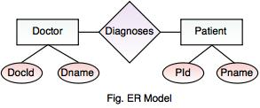
Entity Relationship Model( E-R Model)
High-level data model.
Developed in 1976.
Useful in developing a conceptual design for the database.
Simple and easy to design logical view of data.
Easy to understand the system by looking at an ER model constructed.

Slide 75
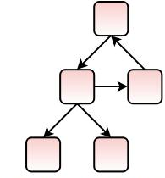
Network Database Model
Similar to Hierarchical Model.
Difference is that it allows a record to have more than one parent.
No need of parent to child association.
Replaces the hierarchical tree with a graph.
Represents the data as record types and one-to-many relationship.
Easy to design and understand.

Slide 76
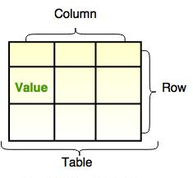
Relational Model
Based on first-order predicate logic.
This model was first proposed by Dr. E. F. Codd.(Father of RDBMS)
It represents data as relations or tables.
Simplifies the database structure by making use of tables and columns.

Slide 77
Advantages of database system
Controlled data redundancy
Enforcing data integrity
Data sharing
Ease of application development
Data security
Multiple user interfaces
Backup and recovery
Program data independence
Data abstraction
Supports multiple views of the data

Slide 78
Object Model
Data Definition Language (DDL).
Data Manipulation Language. (DML).
Data Control Language. (DCL).
Transaction Control Language (TCL).

Slide 79
Schema in RDBMS
A schema in RDBMS defines the structure of a database, such as its tables, attributes (columns), data types, constraints, and relationships between tables. It acts as a blueprint for how data is organized in the database.
Key Components of a Schema:
  Tables: Represent entities (e.g., Employees, Departments).
  Columns (Attributes): Define properties of entities (e.g., EmployeeID, Name).
  Data Types: Define the type of data stored in each column (e.g., INT, VARCHAR).
  Constraints: Rules such as primary keys, foreign keys, and unique constraints.

Slide 80
Schema in RDBMS
Real-World Example:
Imagine you are designing a database for a company’s HR system:
Schema:
  Table 1: Employees (Columns: EmployeeID, Name, DepartmentID, HireDate)
  Table 2: Departments (Columns: DepartmentID, DepartmentName)
This schema defines the structure of the database but doesn’t store any actual data yet.

Slide 81
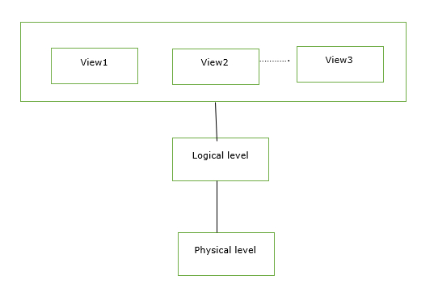
schema
The overall design of the database is called database schema. Schema will not be changed frequently. It is the logical structure of a database. It does not show the data in the database.

Slide 82
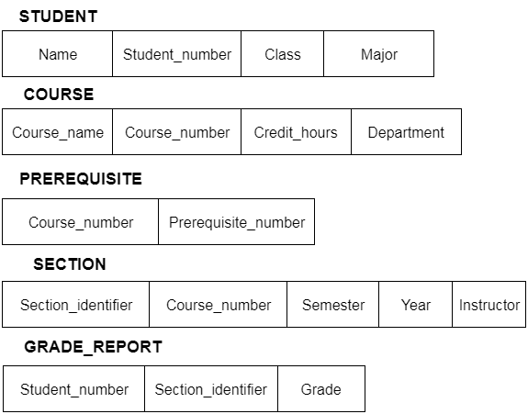
schema
A schema diagram can display only some aspects of a schema like the name of record type, data type, and constraints. Other aspects can't be specified through the schema diagram. For example, the given figure neither show the data type of each data item nor the relationship among various files.
In the database, actual data changes quite frequently. For example, in the given figure, the database changes whenever we add a new grade or add a student. The data at a particular moment of time is called the instance of the database.

Slide 83
Types of Schema
Physical schema − It is a database design at the physical level.It is hidden below the logical schema and can be changed easily without affecting the application programs.
Logical schema − It is a database design at the logical level. Programmers construct applications using logical schema.
External − It is schema at view level. It is the highest level of a schema which defines the views for end users.

Slide 84
Instance
Instance or extension or database state is a collection of information that stored in a database at a particular moment is called an instance of the database. The Database instance refers to the information stored in the database at a given point of time. Thus, it is a dynamic value which keeps on changing.
These refer to a collection of all the information and data stored at any given moment. One can easily change these instances using certain CRUD operations, such as deletion and addition of data and information.
Create, Read, Update, and Delete. These operations are essential for managing data in relational database management systems (RDBMS).

Slide 85
Practical Use Cases of CRUD:
E-Commerce Platform:
  Create: Add new products to the catalog.
  Read: Retrieve product details for customer viewing.
  Update: Change product prices or inventory levels.
  Delete: Remove discontinued products.
Library Management System:
Create: Add new books to the library database.
Read: Search for books based on author or genre.
Update: Update book availability when borrowed.
Delete: Remove lost or damaged books.

Slide 86
Instances in RDBMS
An instance refers to the actual data stored in the database at a particular moment in time. It represents a snapshot of the data based on the schema.
Key Points:
  The schema is static (structure remains the same), but instances can change (data can be updated, inserted, or deleted).
  Instances can vary over time as data operations occur.

Slide 87
Instances in RDBMS
Real-World Example: (Based on the HR system schema)
Initial Instance (at Time T1):
  Employees Table:
  Instance After Data Update (at Time T2):
  Employees Table:
EmployeeID | Name | DepartmentID | HireDate
101 | Alice | 1 | 01-01-2023
102 | Bob | 2 | 15-03-2023
EmployeeID | Name | DepartmentID | HireDate
101 | Alice | 3 | 01-01-2023
102 | Bob | 2 | 15-03-2023

Slide 88
Database States
The state of a database refers to the content (or instance) of the database at any specific point in time. The database state changes as data is inserted, updated, or deleted.
Key Points:
  Initial State: When the database is first created, it may have no data (empty tables).
  Current State: Represents the state of the database after multiple data operations.
Real-World Example:
Initial State: Both Employees and Departments tables are empty.
Current State: As shown in the instances above (at T1 and T2), the database evolves over time with the addition or modification of records.

Slide 89
Schema,instance AND state
Concept | Description | Example
Schema | Structure/blueprint of the database. | Table definitions
Instance | Actual data stored in the database at a given time. | Rows in Employees table
Database State | Snapshot of the database instance at a particular time. | Data at T1 or T2

Slide 90
Difference Between Schema and Instance in DBMS
Parameters | Schema in DBMS | Instance in DBMS
Meaning | Schema refers to the overall description of any given database. | Instance basically refers to a collection of data and information that the database stores at any particular moment.
Alterations | The schema remains the same for the entire database as a whole. | One can change the instances of data and information in a database using updation, deletion, and addition.
Frequency of Change | It does not change very frequently. | It changes very frequently.
Uses | We use Schema for defining the basic structure of any given database. It defines how the available needs to get stored. | We use Instance for referring to a set of information at any given instance/ time.

Slide 91
Data Independence
Data Independence refers to the ability to modify the database schema at one level without affecting the schema at the next higher level. This concept ensures that changes in the structure or storage of the database do not affect the application or user interface.
Data independence is a crucial feature of DBMS and is categorized into two levels:
Logical Data Independence
Physical Data Independence

Slide 92
1. Logical Data Independence
Logical data independence refers to the capacity to change the logical schema without requiring changes to the application programs or external schemas.
Logical Schema: Defines the structure of the database, including tables, columns, relationships, and constraints (e.g., tables for employees, departments, etc.).
Impact: Changing the logical schema should not affect the external views or user applications.
Examples of Logical Changes:
Adding or removing a new column in a table.
Splitting or merging tables.
Changing constraints (e.g., foreign key constraints).

Slide 93
1. Logical Data Independence
Real-World Example:
Consider a university database:
Original Schema: A single Students table with columns: StudentID, Name, DOB.
Change: Add a Major column.
Impact: Application programs querying student names should not need to change, even after adding the Major column.

Slide 94
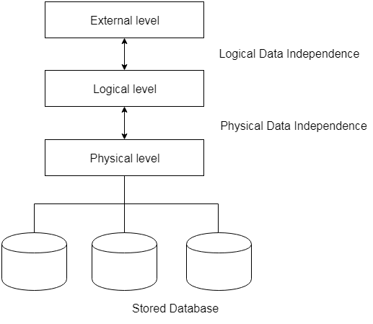
2. Physical Data Independence
Physical data independence refers to the capacity to change the physical schema without requiring changes to the logical schema or application programs.
Physical Schema: Defines how data is stored on storage devices (e.g., file structure, indexing, compression, etc.).
Impact: Changes in the physical storage mechanism should not affect the logical structure or the way data is accessed by users.

Slide 95
2. Physical Data Independence
Examples of Physical Changes:
Moving from one storage format to another (e.g., from flat files to indexed files).
Adding or removing indexes.
Changing data access methods or storage devices.
Real-World Example:
Consider the same university database:
Original Physical Storage: Data stored in a flat file.
Change: Implement indexing for faster retrieval.
Impact: Queries like SELECT * FROM Students will remain the same, even though the underlying storage mechanism has changed.

Slide 96
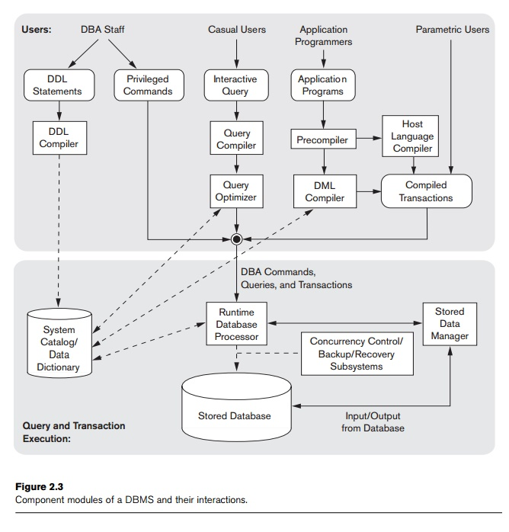
Components MODULES of a dbms and their interactions(database system environment)
https://www.brainkart.com/article/The-Database-System-Environment_11401/

Slide 97
database system environment
The figure is divided into two parts. The top part of the figure refers to the various users of the database environment and their interfaces.
The lower part shows the internals of the DBMS responsible for storage of data and processing of transactions.
A database catalog is essentially a repository of metadata that contains information about the objects in a database.

Slide 98
database system environment :
Query Processor interprets the requests (queries) received from end user via an application program into instructions. It also executes the user request which is received from the DML compiler.
Query Processor contains the following components –
DML Compiler: It processes the DML statements into low level instruction (machine language), so that they can be executed.
DDL Interpreter: It processes the DDL statements into a set of table containing meta data (data about data).
Embedded DML Pre-compiler: It processes DML statements embedded in an application program into procedural calls.
Query Optimizer: It executes the instruction generated by DML Compiler.

Slide 99
database system environment
It shows interfaces for the DBA staff, casual users who work with interactive interfaces to formulate queries, application programmers who create programs using some host programming languages, and parametric users who do data entry work by supplying parameters to predefined transactions.
The DBA staff works on defining the database and tuning it by making changes to its definition using the DDL and other privileged commands.
The DDL compiler processes schema definitions, specified in the DDL, and stores descriptions of the schemas (meta-data) in the DBMS catalog. The catalog includes information such as the names and sizes of files, names and data types of data items, storage details of each file, mapping information among schemas, and constraints. In addition, the catalog stores many other types of information that are needed by the DBMS modules, which can then look up the catalog information as needed.
Casual users and persons with occasional need for information from the database.

Slide 100
Database System Utilities
Loading. A loading utility is used to load existing data files—such as text files or sequential files—into the database.
Backup. A backup utility creates a backup copy of the database, usually by dumping the entire database onto tape or other mass storage medium.
Database storage reorganization. This utility can be used to reorganize a set of database files into different file organizations, and create new access paths to improve performance.
Performance monitoring. Such a utility monitors database usage and provides statistics to the DBA. The DBA uses the statistics in making decisions such as whether or not to reorganize files or whether to add or drop indexes to improve performance.
Other utilities may be available for sorting files, handling data compression, monitoring access by users, interfacing with the network, and performing other functions.

Slide 101
CLIENT SERVER ARCHITECTURE
What is Client-Server Architecture?
  A distributed computing model where tasks and responsibilities are divided between clients (requesters) and servers (providers).
Purpose in DBMS:
  To manage database operations efficiently in a networked environment.
  Ensures centralized data management, scalability, and multi-user support.

Slide 102
CLIENT SERVER ARCHITECTURE
Components of Client-Server Architecture
1. Client:
  Sends requests to the server.
  Example: Application, Web browser.
2. Server:
  Responds to client requests and processes data.
  Example: MySQL Server, Oracle DB Server.
3. Network:
  Connects clients and servers for communication.

Slide 103
CLIENT SERVER ARCHITECTURE
Features of Client-Server Architecture
Centralized Database Management:
  All data is stored on the server for easy access and management.
Multi-user Environment:
  Supports simultaneous access by multiple clients.
Scalability:
  More clients can be added easily by upgrading server capabilities.
Security:
  Data security policies are centralized and easier to enforce.

Slide 104
Types of Client-Server Architecture
1. Two-Tier Architecture
  Direct communication between the client and the database server.
  The application logic resides on the client side.
Advantages:
  Simple design and implementation.
  Faster communication for small systems.
Disadvantages:
  Limited scalability.
  Client overloads with application logic.
Example: MS Access client connecting directly to an SQL Server database.

Slide 105
Types of Client-Server Architecture
2. Three-Tier Architecture
  Introduces an intermediate application server between the client and database server.
  Application logic is handled by the middle layer.
Advantages:
  Better scalability and flexibility.
  Enhanced security (client doesn’t directly access the database).
Disadvantages:
  More complex setup.
Example: Web applications: A client (browser) sends a request to a web server, which communicates with the database server.

Slide 106
Advantages of Client-Server Architecture
Centralized management of databases.
Multi-user access and resource sharing.
Scalability for growing systems.
Improved security through access control on the server.
Simplified maintenance and updates.

Slide 107

Relational Databases Introduction
Introduced by Dr. C. F. Codd in 1970.
Father of RDBMS.
Most widely used data model.
Collects groups of elements into relations.
Each table will include a Primary Key or Identifier.
Ex: Oracle, IBM DB2, and Microsoft SQL Server.
Free and open-source RDBMS, such as MySQL,
Structured Query Language (SQL) to retrieve data elements from a relational database.

Slide 108
Relational Model in DBMS
Relational model makes the query much easier than in hierarchical or network database systems. In 1970, E.F Codd has been developed it.
A relational database is defined as a group of independent tables which are linked to each other using some common fields of each related table.
This model can be represented as a table with columns and rows. Each row is known as a tuple. Each table of the column has a name or attribute.
It is well knows in database technology because it is usually used to represent real-world objects and the relationships between them.
Some popular relational databases are used nowadays like Oracle, Sybase, DB2, MySQL Server etc.

Slide 109
Relational Model Terminologies:
Relation | Table
Tuple | Row, Record
Attribute | Column, Field
Domain | It consists of set of legal values
Cardinality | It consists of number of rows
Degree | It contains number of columns

Slide 110
Relational Model Terminologies:
Relation: A relation is usually represented as a table, organized into rows and columns. A relationship consists of multiple records. For example: student relation which contains tuples and attributes.
Tuple: The rows of a relation that contain the values corresponding to the attributes are called tuples. For example: in the Student relation there are 5 tuples.
The value of tuples contains (10112, Rama, 9874567891,islam ganj, F) etc.
Data Item: The smallest unit of data in the relation is the individual data item. It is stored at the intersection of rows and columns are also known as cells. For Example: 10112, "Rama" etc are data items in Student relation.
Domain: It contains a set of atomic values that an attribute can take. It could be accomplish explicitly by listing all possible values or specifying conditions that all values in that domain must be confirmed. the users to define very simple data types such as numbers, dates, characters etc.
Attribute: The smallest unit of data in relational model is an attribute. It contains the name of a column in a particular table.

Slide 111
Relational Model Terminologies:
Cardinality: The total number of rows at a time in a relation is called the cardinality of that relation. For example: In a student relation, the total number of tuples in this relation is3 so the cardinality of a relation is 3. The cardinality of a relation changes with time as more and more tuples get added or deleted.
Degree: The degree of association is called the total number of attributes in a relationship. The relation with one attribute is called unary relation, with two attributes is known a binary relation and with three attributes is known as ternary relation. F

Slide 112
Relational Database: Example
Provides a logical “human-level” view of the data and associations among groups of data (i.e., tables).

Slide 113
Introduction to Database Design
High-level data model.
Specifies the data requirement of the database users.
Characterize the data needs of the prospective database users.
Interact with domain experts and users to carry out this task.
The outcome of this phase is a specification of user requirements.
To translates into a conceptual schema of the database.
The conceptual-design provides a detailed overview of the enterprise.

Slide 114
Database Design example: a University
The University is organized into departments.
Each Department has a list of courses it offers.
Each Course has associated with it a course id, title, dept name, and credits, and may also have associated prerequisites.
Instructors are identified by their unique ID.
Students are identified by their unique ID.

Slide 115
Example continued..
The University maintains :
List of Classrooms - Specifying the name of the building, room number, and room capacity.
List of all Classes (sections) taught - Each section is identified by a course id, sec id, year, and semester. Associated with it a semester, year, building, room number, and time slot id.
The Department has a list of teaching assignments specifying - each instructor, the sections the instructor is teaching.
The University has a list of all student course registrations, specifying, for each student, the courses and the associated sections that the student has taken (registered for).

Slide 116
Example – University Database Schema
Student (ID, name, dept name, tot cred)
Advisor (s id, i id)
Takes (ID, course id, sec id, semester, year, grade)
Classroom (building, room number, capacity)
Time_slot (time slot id, day, start time, end time)

Slide 117
Schema of the university database
Classroom (building, room_number, capacity)
Department (dept_name, building, budget)
Course (course _d, title, dept name, credits)
Instructor (ID, name, dept_name, salary)
Section (course_id, sec_id, semester, year, building, room_number, time_slot_ id)
Teaches (ID, course_id, sec_id, semester, year)

Slide 118
Schema of the university database CONTINUED..
Student (ID, name, dept_name, tot_cred)
Takes (ID, course_id, sec_id, semester, year, grade)
Advisor (s_ID, i _ID)
Time_slot (time_slot_id, day, start_time, end_time)
Prereq (course id, prereq id).

Slide 119
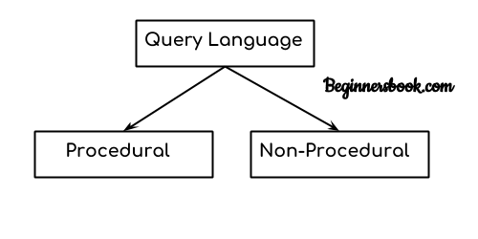
Relational Query Languages
Categorized as either procedural or nonprocedural.
Procedural language, the user instructs the system to perform a sequence of operations on the database to compute the desired result.
Nonprocedural language, the user describes the desired information without giving a specific procedure for obtaining that information.

Slide 120
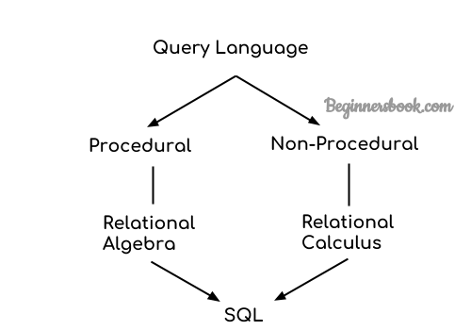
Relational Operations
https://beginnersbook.com/2019/02/introduction-to-relational-algebra-calculus/

Slide 121
Relational Operations continued..
Relational Algebra, Calculus, RDBMS & SQL.
Relational algebra and calculus are the theoretical concepts used on relational model.
RDBMS is a practical implementation of relational model.
SQL is a practical implementation of relational algebra and calculus.

Slide 122
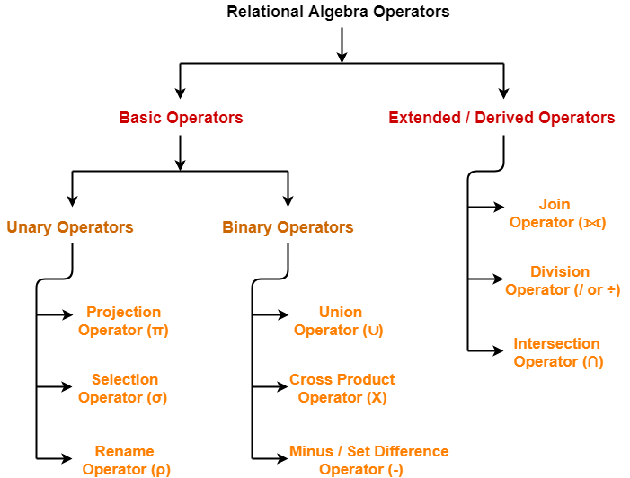
Relational algebra operations
https://www.gatevidyalay.com/projection-operator-relational-algebra-dbms/

Slide 123
Relational algebra operations continued..
In the Relational Model of DBMS (Database Management Systems), operations are used to manipulate and query the data stored in relational tables (also known as relations).
Relational Algebra is a procedural query language or formal query language, which takes instances of one or more relation as an input and generates a new relation as an output. It uses a different set of operators (like unary or binary operators) and operands to perform queries.
In procedural query language every user has to mention two things to access data
These operations can be classified into two broad categories:
Unary Operations: Operations that work on a single relation (table).
Binary Operations: Operations that involve two relations.

Slide 124
Relational algebra operations continued..
Unary Operations
Unary operations are performed on a single relation and typically involve operations like selection, projection, and renaming.
1. Selection (σ)
Purpose: Extracts rows from a relation (table) that satisfy a given condition (predicate). The Greek letter sigma (σ) is used to represent the selection operator.
Operation: The selection operation selects tuples (rows) from a relation based on a condition.
Syntax:
σ(condition)(Relation)

Slide 125
Relational algebra operations continued..
Example: Consider a relation Students with the following schema:
Query: Find all students in the CS department.
σ (Department = 'CS') (Students)
Output is
RollNo | Name | Age | Department
101 | John | 20 | CS
102 | Alice | 22 | EE
103 | Bob | 21 | ME
104 | Carol | 23 | CS
RollNo | Name | Age | Department
101 | John | 20 | CS
104 | Carol | 23 | CS

Slide 126
Relational algebra operations continued..
2. Projection (π)
Purpose: Extracts specific columns (attributes) from a relation.
Operation: The projection operation selects certain columns and eliminates duplicates if necessary. The Greek letter pi (π) is used to represent the projection operator.
Syntax: π(Column1, Column2, ...)(Relation) eg:∏Roll_no,Name(Students)
Example: Using the same Students relation, suppose you want to display only the Name and Department of the students:
Π (Name, Department) (Students)
Result:
Example: Retrieve Roll_no,
Name of the students who admited in CSE ∏Roll_no,Name(σBranch='cse'(Students)
Name | Department
John | CS
Alice | EE
Bob | ME
Carol | CS

Slide 127
Relational algebra operations continued..
3. Renaming (ρ)
Purpose: Renames the relation or attributes for clarity in complex queries.
Operation: Renames a relation or one or more of its attributes. Renames columns or tables. The Greek letter rho (ρ) is used to represent the rename operator.
Syntax: ρ(NewRelationName, [NewAttributeNames])(Relation)
Example: To rename the relation Students to Enrolled:
ρ(Enrolled)(Students)
Result: The table Students will now be referred to as Enrolled.

Slide 128
Relational algebra operations continued..
Binary Operations
Binary operations involve two relations and include operations like union, intersection, difference, and join. These operations are performed between relations that have compatible schemas (i.e., the same number of attributes and the same domain for each attribute).
1. Union (∪)
Purpose: Combines all rows from two relations and removes duplicates.
Operation: The union operation takes the set of all tuples that are present in either of the two relations.
Syntax: Relation1 ∪ Relation2

Slide 129
Relational algebra operations continued..
Example: Consider two relations CS_Students and EE_Students:
Query: Find all students of CS and EE departments.
CS_Students ∪ EE_Students
Result:
RollNo | Name | Age | Department
101 | John | 20 | CS
104 | Carol | 23 | CS
RollNo | Name | Age | Department
102 | Alice | 22 | EE
105 | Eve | 21 | EE
RollNo | Name | Age | Department
101 | John | 20 | CS
104 | Carol | 23 | CS
102 | Alice | 22 | EE
105 | Eve | 21 | EE

Slide 130
Relational algebra operations continued..
2. Intersection (∩)
Purpose: Returns the common tuples (rows) that exist in both relations.
Operation: The intersection operation takes the set of all tuples that are present in both relations.
Syntax: Relation1 ∩ Relation2
Example: Using CS_Students and EE_Students again, suppose you want to find the students common to both CS and EE departments. (Note: In real life, this scenario is unlikely unless they are in both departments!)
CS_Students ∩ EE_Students
Result: Since there are no common students between the two departments, the result will be an empty set.

Slide 131
Relational algebra operations continued..
2. In relational algebra, the intersection operator is used to retrieve the set of tuples that are present in both of two relations (tables). This operator works only when the relations are union-compatible, meaning they have the same schema (i.e., the same attributes and their corresponding domains).
Let R and S be two relations.
R:
S:
A | B
3 | 4
7 | 8
5 | 6
Intersection:
The tuples common to both R and S are:
A | B
1 | 2
3 | 4
5 | 6
A | B
3 | 4
5 | 6

Slide 132
Relational algebra operations continued..
3. Difference (−)
Purpose: Returns the tuples that exist in the first relation but not in the second relation.
Operation: The difference operation subtracts tuples in the second relation from the first relation.
Syntax: Relation1 − Relation2
Example: Find students who are in the CS_Students relation but not in EE_Students:
CS_Students − EE_Students
Result:
RollNo | Name | Age | Department
101 | John | 20 | CS
104 | Carol | 23 | CS

Slide 133
Relational algebra operations continued..
3. Difference (−)
Table: Enrolled_Students
Fee_Paid_Students
StudentID | Name | Course
101 | Alice | Computer Sci
102 | Bob | Mathematics
103 | Charlie | Physics
104 | Diana | Chemistry
StudentID | Name | Course
101 | Alice | Computer Sci
103 | Charlie | Physics
Set Difference: Enrolled_Students - Fee_Paid_Students
We want to find students who are enrolled but have not paid tuition fees. The result will include tuples in Enrolled_Students
that are not in Fee_Paid_Students.
StudentID | Name | Course
102 | Bob | Mathematics
104 | Diana | Chemistry

Slide 134
Relational algebra operations continued..
3. SQL Query:
SELECT StudentID, Name, Course
FROM Enrolled_Students
EXCEPT
SELECT StudentID, Name, Course
FROM Fee_Paid_Students;

Slide 135
Relational algebra operations continued..
4. Cartesian Product (×)
Purpose: Combines every tuple in the first relation with every tuple in the second relation.
Operation: The Cartesian product returns the concatenation of every tuple from the first relation with every tuple from the second relation.
Syntax: Relation1 × Relation2

Slide 136
Relational algebra Operations continued..
Example: Consider two relations Courses and Instructors:
Query: Find the Cartesian product of Courses and Instructors:
Courses × Instructors
Result:
CourseID | CourseName
C101 | DBMS
C102 | OS
InstructorID | InstructorName
I201 | Dr. Smith
I202 | Dr. Jones
CourseID | CourseName | InstructorID | InstructorName
C101 | DBMS | I201 | Dr. Smith
C101 | DBMS | I202 | Dr. Jones
C102 | OS | I201 | Dr. Smith
C102 | OS | I202 | Dr. Jones

Slide 137
Relational algebra operations continued..
5. Join Operation (⋈)
Purpose: Combines related tuples from two relations based on a common attribute (usually a foreign key relationship).
Operation: The join operation is used to combine rows from two or more tables based on a related column.
Syntax: Relation1 ⋈ Condition(Relation2)
Example: Given Courses and Instructors relations, suppose there is a Teaching relation that links them:
CourseID | InstructorID
C101 | I201
C102 | I202

Slide 138
Relational algebra operations continued..
Join operator
Join operator denoted by ⨝. A Join operation combines related tuples from different relations.
Join operators can apply, if and only if there must be some common attributes in two relations, It is used when we need to access data from more than one Relations.
Join operator = cross product + condition
Types of JOINs:
1. Inner Join (Natural Join)
2. Outter Join (Left Outter Join Right Outter Join Full Outter Join)

Slide 139
Relational algebra operations continued..
Join operator
1. Inner Join
In an inner join, only those tuples that satisfy the matching criteria are included, while the rest are excluded.
Natural Join
Natural join can only be performed if there is a common attribute (column) between the relations. The name and type of the attribute must be same(one as a primary key and other as foreign key).
Syntax : R1 ⨝ R2

Slide 140
Relational algebra operations continued..
Join operator
2. Outter Join
In an outer join, along with tuples that satisfy the matching criteria, we also include some or all tuples that do not match the criteria. There are three types of outer joins:
  Left Outter Join (⟕):
  Returns all rows from the left table and the matching rows from the right table. If there is no match, NULL values are returned for columns from the right table.
  Syntax: R1 ⟕ R2

Slide 141
Relational algebra operations continued..
Join operator
  2. Right Outter Join (⟖)
  Returns all rows from the right table and the matching rows from the left table. If there is no match, NULL values are returned for columns from the left table.
  Syntax : R1 ⟖ R2
  3.Full Outter Join (⟗)
  Returns all rows when there is a match in either table. If there is no match, NULL values are returned for columns that don't have a match in either table.
  Syntax: R1 ⟗ R2

Slide 142
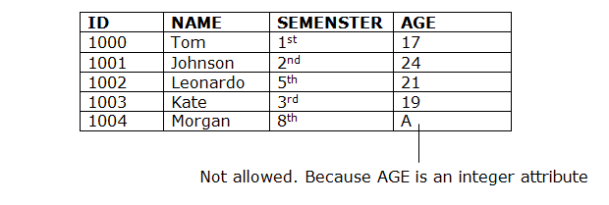
1. Domain constraints
Domain constraints can be defined as the definition of a valid set of values for an attribute.
The data type of domain includes string, character, integer, time, date, currency, etc. The value of the attribute must be available in the corresponding domain.

Slide 143
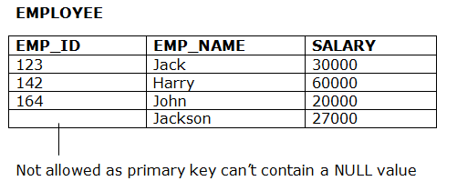
Entity integrity constraints
The entity integrity constraint states that primary key value can't be null.
This is because the primary key value is used to identify individual rows in relation and if the primary key has a null value, then we can't identify those rows.
A table can contain a null value other than the primary key field.

Slide 144
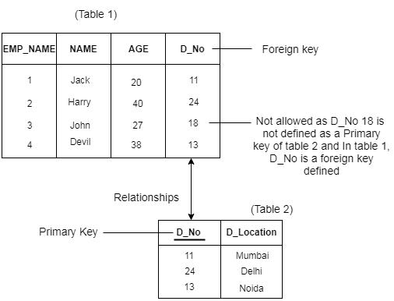
Referential Integrity Constraints
A referential integrity constraint is specified between two tables.
In the Referential integrity constraints, if a foreign key in Table 1 refers to the Primary Key of Table 2, then every value of the Foreign Key in Table 1 must be null or be available in Table 2.

Slide 145
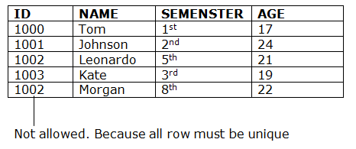
Key constraints
Keys are the entity set that is used to identify an entity within its entity set uniquely.
An entity set can have multiple keys, but out of which one key will be the primary key. A primary key can contain a unique and null value in the relational table.

Slide 146
Centralized and Client-Server Architectures
In Database Management Systems (DBMS), centralized and client-server architectures represent two distinct approaches to data management, each with its own set of characteristics, advantages, and disadvantages.
Centralized Architecture:
In a centralized architecture, all database resources are located and maintained in a single, central location, typically on a mainframe or a central server. Users access the database through terminals or networked computers that connect to this central system.
In a centralized database system, all the database management is done on a single central server or mainframe. The database and DBMS software are stored on this server, and users access it through terminals or computers.

Slide 147
Centralized and Client-Server Architectures
Features of Centralized DBMS:
The central server handles all processing, from query processing to data retrieval.
End-users interact with the database through simple interfaces (e.g., terminals or web-based UIs).
Advantages:
Simplicity: Centralized control ensures consistency, as all data resides in a single location.
Data Security: Only one point of access needs to be secured.
Ease of Administration: Backup, maintenance, and software updates are easier to manage.
4.Data Integrity and Consistency: With all data stored in one location, it's easier to maintain data integrity and consistency, as there is a single source of truth.
5.Simplified Management: Centralized control simplifies database administration tasks such as backups, updates, and security management.

Slide 148
Centralized and Client-Server Architectures
Disadvantages:
Single Point of Failure: The central server represents a single point of failure; if it goes down, all users lose access to the database.
Scalability Limitations: As the number of users grows, the central system may become a bottleneck, leading to performance issues.
Example of Centralized system:
A university's student records system where all data is stored on a central server, and administrative staff access it through networked terminals.

Slide 149
Centralized and Client-Server Architectures
Client-Server Architecture:
In a client-server architecture, the database system is divided into two parts: the client and the server. The server hosts the database and handles data storage and management, while clients are applications or interfaces through which users interact with the database.
In client-server architecture, the database system is divided into two components:
Client: The front-end application that handles user interaction and some local processing (e.g., a desktop or mobile app).
Server: The back-end system that stores and manages the database and processes queries from clients.
Features of Client-Server DBMS:
The client submits requests (SQL queries), and the server processes these and sends results back.
It supports distributed computing, where processing can happen on both client and server sides.

Slide 150
Centralized and Client-Server Architectures
Advantages:
Improved Performance: Clients can perform some processing tasks locally, reducing the load on the server and improving overall system performance.
Scalability: It's easier to add more clients to the system without significantly affecting the server's performance.
Disadvantages:
Complexity: The system is more complex to design and maintain due to the need for effective communication between clients and the server.
Network Dependency: The performance of the system heavily depends on the reliability and speed of the network connecting clients and the server.
Example of client server architecture: An online banking system where the central database server manages account information, and customers access their accounts through client applications on their computers or mobile devices.

Slide 151
Classification of DBMS
A Database Management System (DBMS) is software used to store, retrieve, and manage data in databases. DBMS can be classified based on several factors such as the type of data it handles, the architecture it follows, or the model it supports.
DBMS may be classified into various ways.
Classification Based on Data Model
2. Classification Based on Database Distribution
3. Classification Based on User Count
4. Classification Based on Usage
5. Classification Based on Access

Slide 152
Classification of DBMS
1. Classification Based on Data Model
The data model defines how data is organized, stored, and manipulated. The major types of DBMS based on data models are:
a. Hierarchical DBMS
In a hierarchical DBMS, data is organized in a tree-like structure where a parent node can have multiple child nodes, but a child node will have only one parent. Relationships are represented as one-to-many.
Example: Information Management System (IMS)
Managing data in applications like banking and telecommunications.
Example: A company can have multiple employees and departments, but each employee or department belongs to one company.

Slide 153
Classification of DBMS
b. Network DBMS
The network model represents data as records (nodes) connected by relationships (edges). It allows many-to-many relationships.
Example: Handling complex relationships, such as supply chain management.
Example Structure:
Employees
├── Works_in
└── Projects
└── Departments

Slide 154
Classification of DBMS
C.Relational DBMS (RDBMS)
Data is organized into tables (relations) consisting of rows (records) and columns (attributes). Relationships between tables are defined using keys.
Example: MySQL, PostgreSQL, Oracle DB
Widely used in most applications like e-commerce, finance, and healthcare.
d. Object-Oriented DBMS (OODBMS)
Combines the features of object-oriented programming with database principles. Data is stored as objects, and relationships are represented using references.

Slide 155
Classification of DBMS
2. Classification Based on Database Distribution
a. Centralized DBMS
Data is stored and managed in a single central location, and users access it over a network.
Example: A university database storing all records in one server.
Advantages: Easy to maintain and secure.
Disadvantages: High dependency(More no.of users) on the central server, which can cause bottlenecks.

Slide 156
Classification of DBMS
2. Classification Based on Database Distribution
b. Distributed DBMS (DDBMS)
Data is distributed across multiple locations, connected by a network, but the system behaves as a single database to users.
Advantages: High availability and fault tolerance.
Disadvantages: Complexity in synchronization and consistency.
C. Federated DBMS(Multi database system):
Combines multiple databases into a single system without physically merging them.
Example: A global organization managing regional databases in different countries.

Slide 157
3. Classification Based on User Count
a. Single-User DBMS
Description: Designed for one user at a time.
Example: Microsoft Access
Use Case: Personal or small business use.
b. Multi-User DBMS
Description: Allows multiple users to access and manipulate the database simultaneously.
Example: MySQL, Oracle
Use Case: Enterprise-level applications.

Slide 158
4. Classification Based on Usage
a. OLTP (Online Transaction Processing)
OLTP stands for Online Transaction Processing. OLTP has the work to administer day-to-day transactions in any organization. The main goal of OLTP is data processing not data analysis.
Online Transaction Processing, commonly known as OLTP, is a data processing approach emphasizing real-time execution of transactions.
The majority of OLTP systems are meant to manage numerous short atomic operations that keep databases in line.
To maintain transaction integrity and reliability, these systems support ACID (Atomicity, Consistency, Isolation, Durability) properties.
It is through this that numerous unavoidable applications run their critical courses like online banking, reservation systems etc.

Slide 159
4. Classification Based on Usage
a. OLTP (Online Transaction Processing)
Key Features of OLTP:
Transactional Workloads: Focuses on short, fast, and frequent transactions.
Data Modification: Involves real-time data updates and changes.
Normalized Database Design: Data is highly normalized (split into multiple related tables) to reduce redundancy.
High Concurrency: Allows multiple users to perform transactions simultaneously.
Low Latency: Transactions are quick, typically completed in milliseconds.

Slide 160
4. Classification Based on Usage
a. OLTP (Online Transaction Processing)
Benefits of OLTP Services
OLTP services allow users to read, write and delete data operations quickly.
OLTP services help in increasing users and transactions which helps in real-time access to data.
OLTP services help to provide better security by applying multiple security features.
OLTP services help in making better decision making by providing accurate data or current data.
OLTP Services provide Data Integrity, Consistency, and High Availability to the data.
Drawbacks of OLTP Services
OLTP has limited analysis capability as they are not capable of intending complex analysis or reporting.
OLTP has high maintenance costs because of frequent maintenance, backups, and recovery.
OLTP Services get hampered in the case whenever there is a hardware failure which leads to the failure of online transactions.
OLTP Services many times experience issues such as duplicate or inconsistent data.

Slide 161
4. Classification Based on Usage
a. OLTP (Online Transaction Processing)
Example Use Cases:
Banking: Managing deposits, withdrawals, and fund transfers.
E-commerce: Recording orders, payments, and customer details.
Retail: Updating inventory and processing sales.
An example considered for OLTP System is ATM Center a person who authenticates first will receive the amount first and the condition is that the amount to be withdrawn must be present in the ATM. The uses of the OLTP System are described below.
ATM center is an OLTP application.
OLTP handles the ACID properties during data transactions via the application.
It’s also used for Online banking, Online airline ticket booking, sending a text message, add a book to the shopping cart.

Slide 162
4. Classification Based on Usage
b. OLAP (Online Analytical Processing)
OLAP Stands for Online Analytical Processing. OLAP systems have the capability to analyze database information of multiple systems at the current time.
The primary goal of OLAP Service is data analysis and not data processing.
Online Analytical Processing (OLAP) refers to software tools used for the analysis of data in business decision-making processes.
OLAP systems generally allow users to extract and view data from various perspectives, many times they do this in a multidimensional format which is necessary for understanding complex interrelations in the data.
These systems are part of data warehousing and business intelligence, enabling users to do things like trend analysis, financial forecasting, and any other form of in-depth data analysis.

Slide 163
4. Classification Based on Usage
b. OLAP (Online Analytical Processing)
Benefits of OLAP Services
OLAP services help in keeping consistency and calculation.
We can store planning, analysis, and budgeting for business analytics within one platform.
OLAP services help in handling large volumes of data, which helps in enterprise-level business applications.
OLAP services help in applying security restrictions for data protection.
OLAP services provide a multidimensional view of data, which helps in applying operations on data in various ways.
Drawbacks of OLAP Services
OLAP Services requires professionals to handle the data because of its complex modeling procedure.
OLAP services are expensive to implement and maintain in cases when datasets are large.
We can perform an analysis of data only after extraction and transformation of data in the case of OLAP which delays the system.
OLAP services are not efficient for decision-making, as it is updated on a periodic basis.

Slide 164
4. Classification Based on Usage
b. OLAP (Online Analytical Processing)
Example Use Cases:
Business Intelligence: Generating sales trends or analyzing customer behavior.
Data Warehousing: Consolidating data from multiple sources for reporting and analysis.
Forecasting: Predicting future sales based on historical data.
OLAP Example:
Any type of Data Warehouse System is an OLAP system. The uses of the OLAP System are described below.
Query the total sales amount by region and month.
Identify the top-performing products for the last quarter.
analyzing data rather than modifying it.
Spotify analyzed songs by users to come up with a personalized homepage of their songs and playlists.
Netflix movie recommendation system.

Slide 165
Difference Between OLAP and OLTP
Category | OLAP (Online Analytical Processing) | OLTP (Online Transaction Processing)
Definition | It is well-known as an online database query management system. | It is well-known as an online database modifying system.
Data source | Consists of historical data from various Databases. | Consists of only operational current data.
Method used | It makes use of a data warehouse. | It makes use of a standard database management system (DBMS).
Application | It is subject-oriented. Used for Data Mining, Analytics, Decisions making, etc. | It is application-oriented. Used for business tasks.
Normalized | In an OLAP database, tables are not normalized. | In an OLTP database, tables are normalized (3NF).

Slide 166
Difference Between OLAP and OLTP
Usage of data | The data is used in planning, problem-solving, and decision-making. | The data is used to perform day-to-day fundamental operations.
Task | It provides a multi-dimensional view of different business tasks. | It reveals a snapshot of present business tasks.
Purpose | It serves the purpose to extract information for analysis and decision-making. | It serves the purpose to Insert, Update, and Delete information from the database.
Volume of data | A large amount of data is stored typically in TB, PB | The size of the data is relatively small as the historical data is archived in MB, and GB.
Queries | Relatively slow as the amount of data involved is large. Queries may take hours. | Very Fast as the queries operate on 5% of the data.
Update | The OLAP database is not often updated. As a result, data integrity is unaffected. | The data integrity constraint must be maintained in an OLTP database.
Backup and Recovery | It only needs backup from time to time as compared to OLTP. | The backup and recovery process is maintained rigorously

Slide 167
Constraints on Relational Database Model
In modeling the design of the relational database we can put some restrictions like what values are allowed to be inserted in the relation, and what kind of modifications and deletions are allowed in the relation. These are the restrictions we impose on the relational database.
In models like Entity-Relationship models, we did not have such features.
Database Constraints can be categorized into 3 main categories:
Constraints that are applied in the data model are called Implicit Constraints.
Constraints that are directly applied in the schemas of the data model, by specifying them in the DDL(Data Definition Language). These are called Schema-Based Constraints or Explicit Constraints.
Constraints that cannot be directly applied in the schemas of the data model. We call these Application-based or Semantic Constraints.

Slide 168
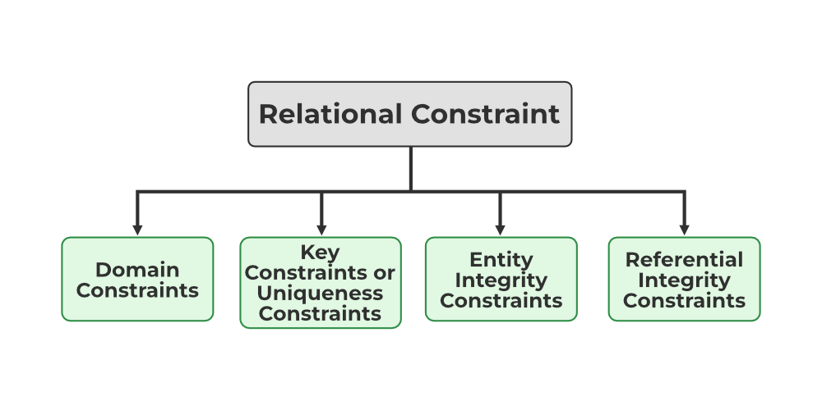
Constraints on Relational Database Model
Relational Constraints
These are the restrictions or sets of rules imposed on the database contents.
It validates the quality of the database. It validates the various operations like data insertion, updation, and other processes that have to be performed without affecting the integrity of the data.
It protects us against threats/damages to the database.
Mainly Constraints on the relational database are of 4 types
  Domain constraints
  Key constraints or Uniqueness Constraints
  Entity Integrity constraints
  Referential integrity constraints

Slide 169
  1.Domain constraints
Every domain must contain atomic values(smallest indivisible units) which means composite and multi-valued attributes are not allowed.
We perform a datatype check here, which means when we assign a data type to a column we limit the values that it can contain.
Eg. If we assign the datatype of attribute age as int, we can’t give it values other than int datatype.
Example:
EID | Name | Phone
01 | Bikash Dutta | 123456789 234456678
In the above relation, Name is a composite attribute and Phone is a multi-values attribute, so it is violating domain constraint.

Slide 170
2. Key Constraints or Uniqueness Constraints
These are called uniqueness constraints since it ensures that every tuple in the relation should be unique.
A relation can have multiple keys or candidate keys(minimal superkey), out of which we choose one of the keys as the primary key, we don’t have any restriction on choosing the primary key out of candidate keys, but it is suggested to go with the candidate key with less number of attributes.
Null values are not allowed in the primary key, hence Not Null constraint is also part of the key constraint.
Example:
EID | Name | Phone
01 | Bikash | 6000000009
02 | Paul | 9000090009
01 | Tuhin | 9234567892
In this table, EID is the primary key, and the first and the last tuple have the same value in EID ie 01, so it is violating the key constraint.

Slide 171
3. Entity Integrity Constraints
Entity Integrity constraints say that no primary key can take a NULL value, since using the primary key we identify each tuple uniquely in a relation.
Example:
In this relation, EID is made the primary key, and the primary key can’t take NULL values but in the third tuple, the primary key is null, so it is violating Entity Integrity constraints.
EID | Name | Phone
01 | Bikash | 9000900099
02 | Paul | 600000009
NULL | Sony | 9234567892

Slide 172
4. Referential Integrity Constraints
The Referential integrity constraint is specified between two relations or tables and used to maintain the consistency among the tuples in two relations.
This constraint is enforced through a foreign key, when an attribute in the foreign key of relation R1 has the same domain(s) as the primary key of relation R2, then the foreign key of R1 is said to reference or refer to the primary key of relation R2.
The values of the foreign key in a tuple of relation R1 can either take the values of the primary key for some tuple in relation R2, or can take NULL values, but can’t be empty.
Example:
EID | Name | DNO
01 | Divine | 12
02 | Dino | 22
04 | Vivian | 14
DNO | Place
12 | Jaipur
13 | Mumbai
14 | Delhi
In the above tables, the DNO of Table 1 is the foreign key, and DNO in Table 2 is the primary key. DNO = 22 in the foreign key of Table 1 is not allowed because DNO = 22 is not defined in the primary key of table 2.
Therefore, Referential integrity constraints are violated here.

Slide 173
THANK YOU

